Slide 1


Interactive Statues

Slide 2

Our Supervisors
Team Members
Dr. Ayat Mohammed
Essam El-Din Sheriff – CS Department
Abdullah Ramadan – CS Department
TA. Zeina Rayan
Hassan Walid – CS Department
Amr Zakaria – CS Department
TA. Mohammed Essam
Omar Hany – CS Department

Slide 3
Table Of Content
01
02
03
04
05
06
07
Problem Definition
System Architecture
Phases Description
Experiments & Results
Dataset
Demo
08
Conclusion&Future Work
Achievements

Slide 4
01
Problem Definition

Slide 5
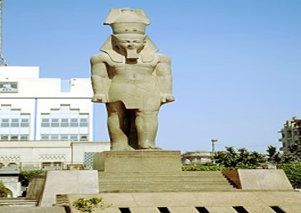
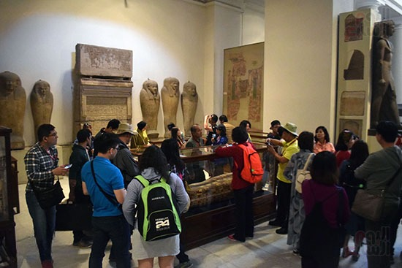
Introduction

Slide 6


Introduction cont.
Wait a Long time
The tourism trips cost
So, we decided make a mobile app
Replace the manual guiding method with the automated guiding method.

Slide 7
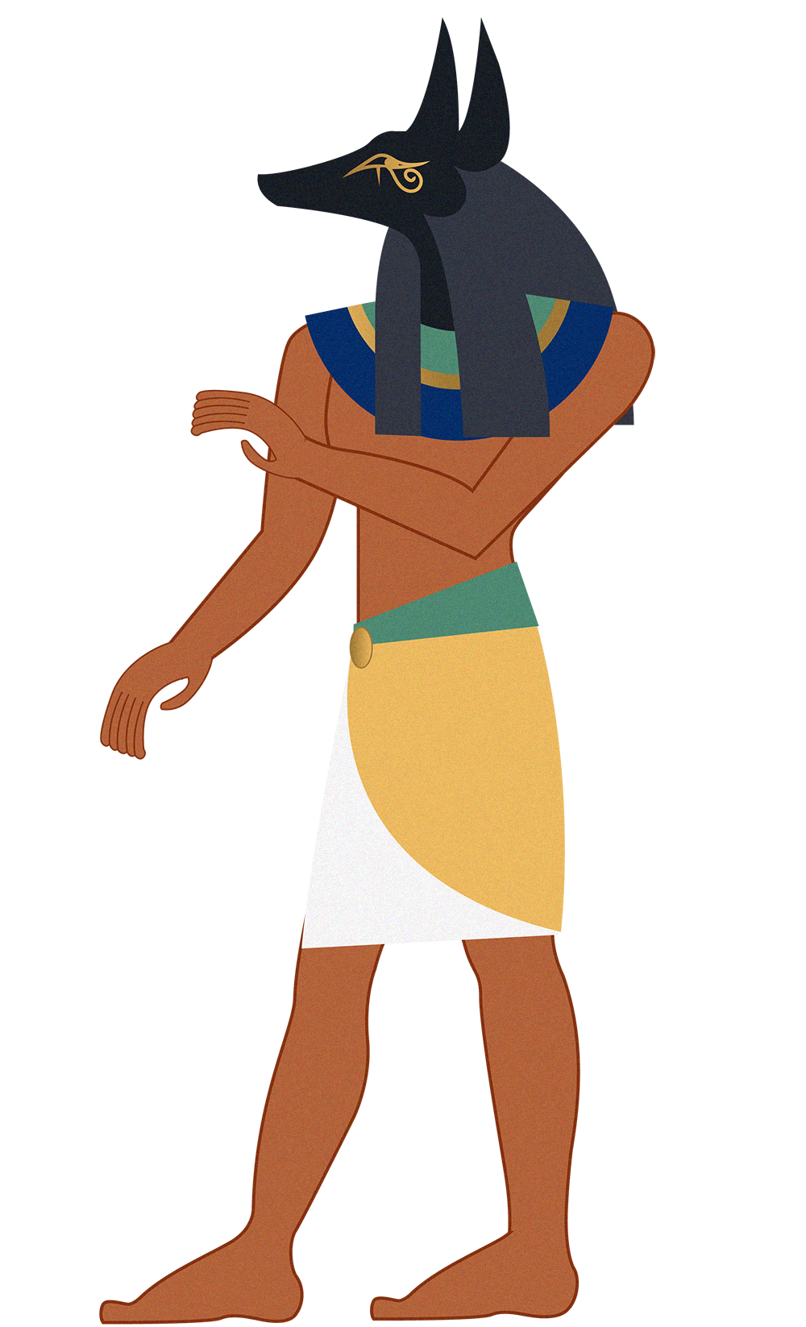
Motivation
App helps people to visit several places without tour guide
App helps people expand their knowledge about statues
App helps fuel tourism in Egypt
App reduce the need to carry printed brochures or obtain a tour guide
App will be used over the coming years

Slide 8

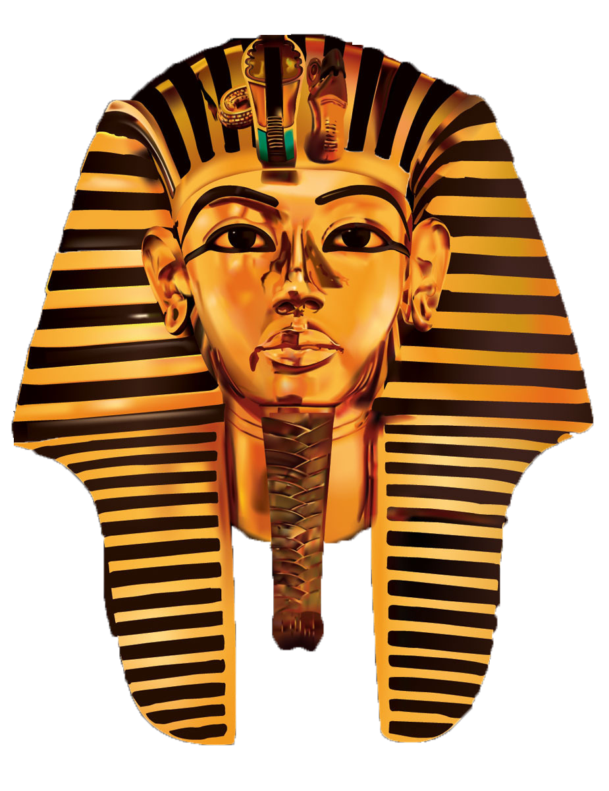

Objectives
Develop an easy-to-use mobile app
Help user to know everything about statue
Give information about statue by interactive way
Reduce cost for tourist
Helping in Education Field
Increases public awareness of the Egyptian civilization

Slide 9
02
System Architecture

Slide 10

System Architecture
Application Layer
User Interface
Image Recognition Layer
Statue Image
Preprocessing
Image
Face Detection
Face
Classification
Face ID
Voice Recognition Layer
voice
processed-Text
Text
processed-Text
Google Cloud speech-to-text API
Text
Preprocessing
Preprocessing
NLP Search algorithm
NLP Search algorithm
Question Number
Deepfake Layer
Database Layer
Statue image
Create Videos
(First Order Motion)
Video
Driving Video
Video
10

Slide 11
03
Phases Description

Slide 12

Phases description (Cont.…)
Application Layer (Finished)
efficient user-friendly android tour-guide application to take photos of status, questions about statues, and return deepfake video

Slide 13
Phases description (Cont.…)
Face Recognition Layer (Finished)
Statue Image
Preprocessing
Image
Face Detection
Face
Classification
Face ID
Best result is CNN (VGG-19 architecture) as deep learning model
Relation between accuracy and number of classes & accuracy and number of epochs
Preprocessing in CNN papers:
Resizing images.
Removing noise from images.
Removing classes that have few images or make Augmentation .

Slide 14
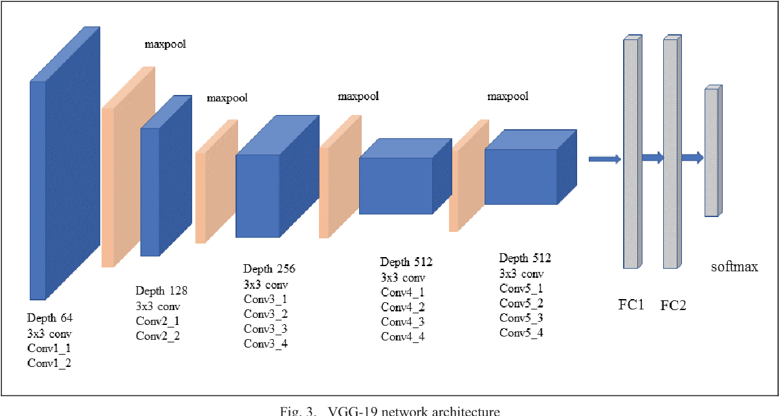
Phases description (Cont.…)
CNN model
VGG-19 Architecture
S. C. Arishanapally, "Medium," 16 April 2019. [Online]. Available: https://saicharanars.medium.com/building-vgg19-with-keras-f516101c24cf. [Accessed 4 April 2023](Link)

Slide 15
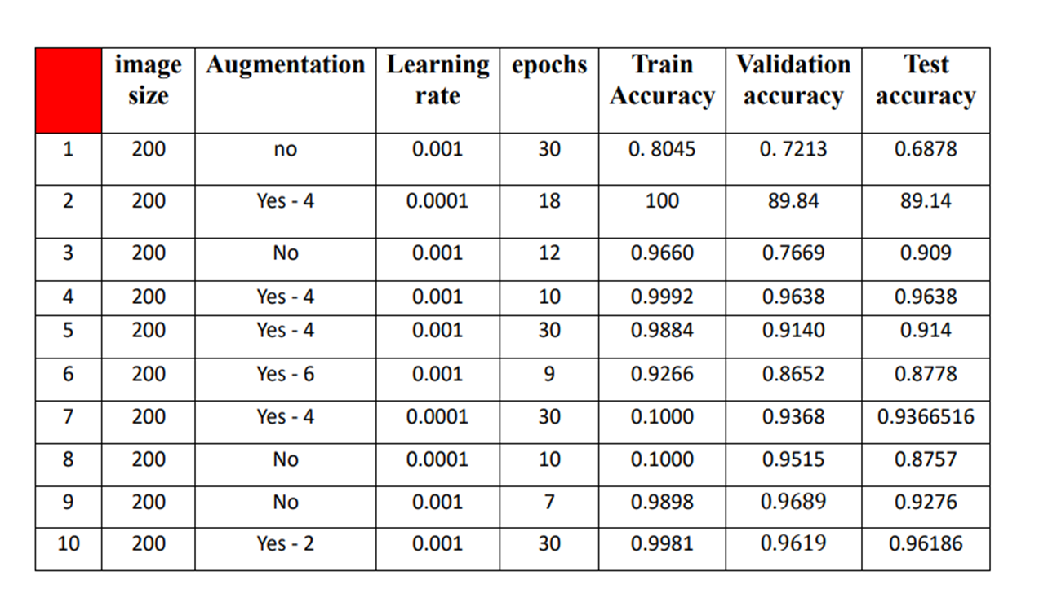
Phases description (Cont.…)
CNN model
VGG-19 Trials

Slide 16
Phases description (Cont.…)
Deep Fake Layer (Finished)
Statue image
Create Videos
(First Order Motion)
Target Video
Driving Video
Best result is the first order motion as deep fake model
Preprocessing for first order motion Model:
Extract an initial bounding box in the first video frame
Track the face
Filtering out the lower resolution than 256*256 in the video
Resize the video to 256*256

Slide 17
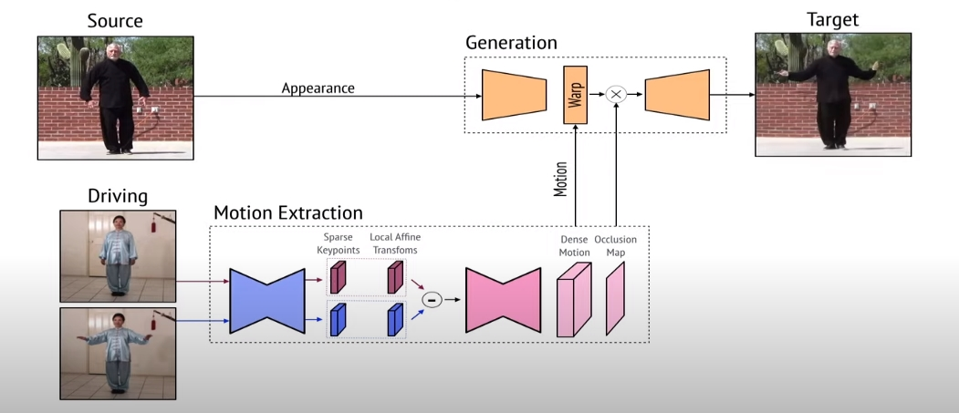
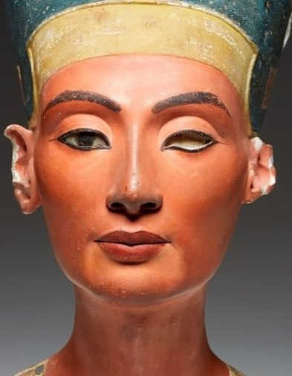
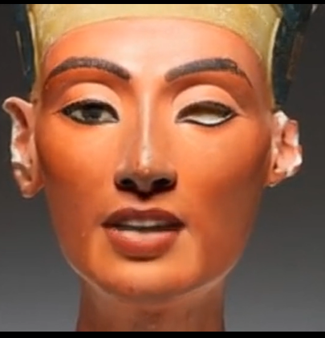
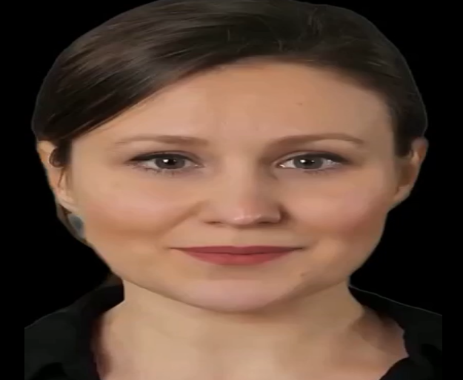
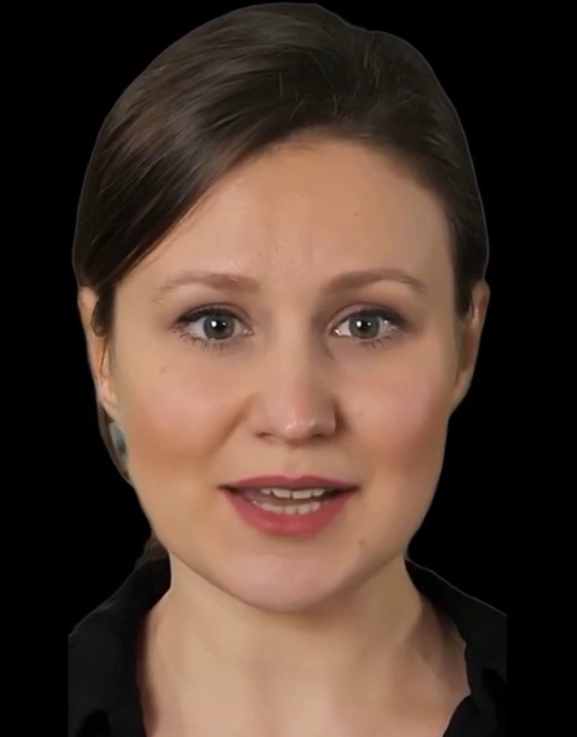
Phases description (Cont.…)
Deep Fake model
First-Order-Motion

Slide 18
Phases description (Cont.…)
Phases description (Cont.…)
Voice Recognition Layer (Finished)
voice
Google Cloud API
Text
Preprocessing
processed-Text
NLP Search algorithm
Question Number
Take the question record as input from user then analyze it and finally extract question number.
Use Google cloud API to extract question text from the record.
Use NLP technique to match with our keywords.

Slide 19
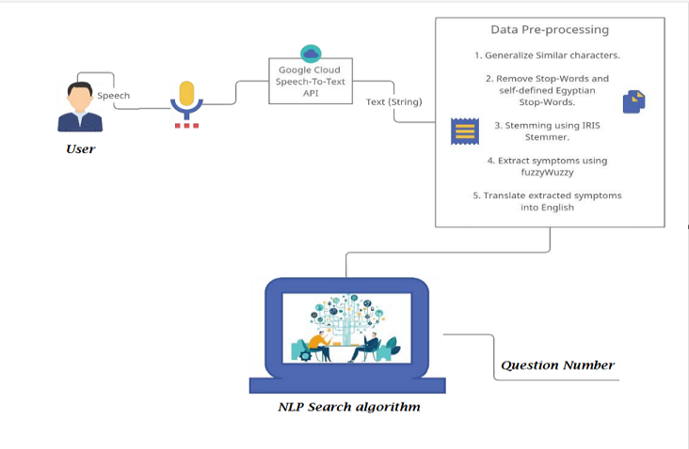
Phases description (Cont.…)
Voice Recognition Layer (Finished)

Slide 20
Phases description (Cont.…)
Database Layer (Finished)
Database Layer
Face Id & Question number
Fake video
upload video
By using Firebase:
Upload Fake videos from desktop application.
Get Face ID and Question number from the user.
Match with the database to get the right video.

Slide 21
04
Dataset

Slide 22

Dataset
Dataset is divided into TWO partitions:
The Textual which each statue can answer it by video.
Statues images which used in Deep learning model.

Slide 23
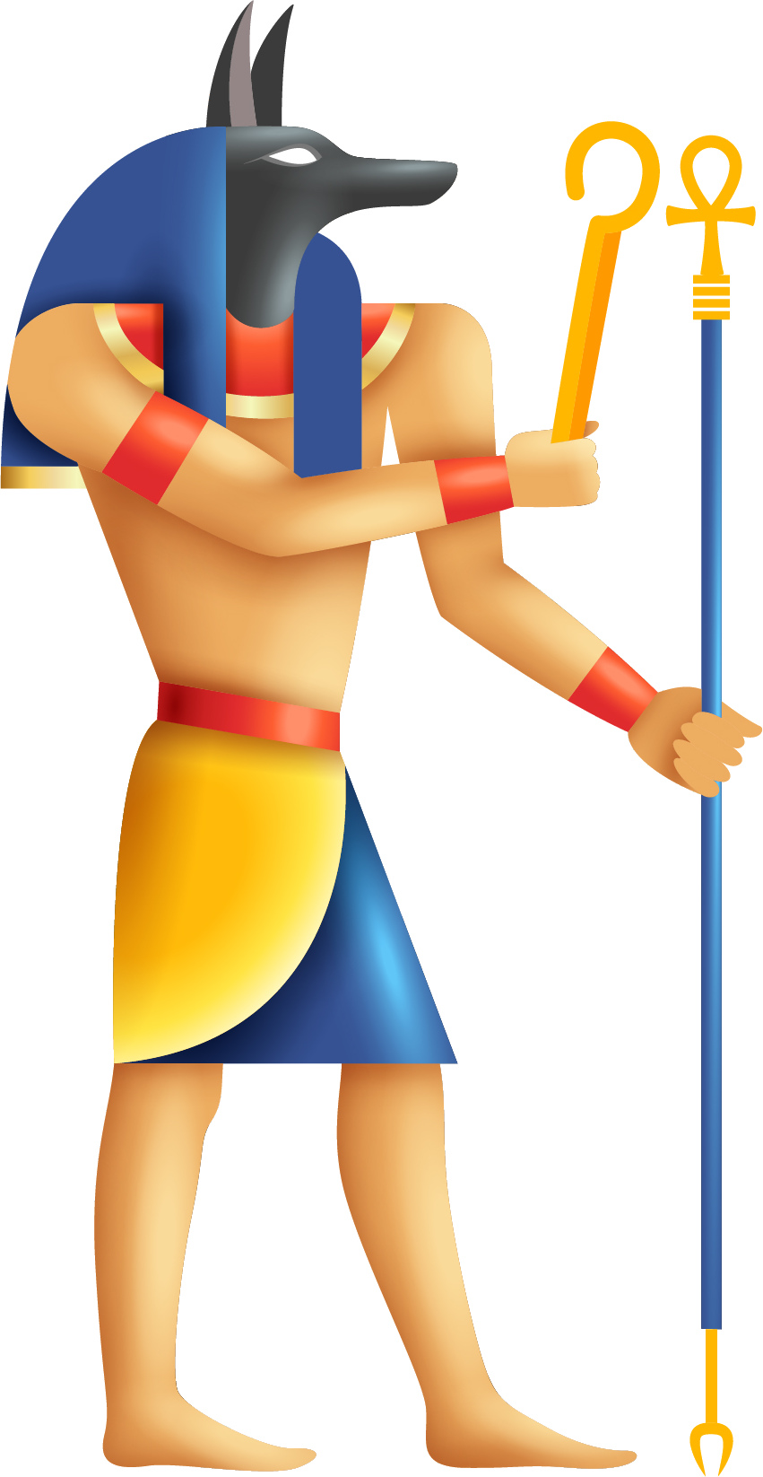
Dataset Cont.
Dataset problem and how we solve it
At First, Data from internet only, but there was a problem:
Few images and low resolution
First solution, Using Augmentation.
The result: low accuracy.
Second solution,
By going to the museum.
Make Integration between new and online images.
Then used Augmentation.
The result: high accuracy.

Slide 24
Dataset Cont.
Special Thanking to:
Prof.Dr. Azza Farouk Sayed, Department of Egyptian Antiquities
Dr. Adel Nasr El-Din, Department of Egyptian Antiquities
TA. Alaa Ehab Abdul-Aziz, Department of Egyptian Antiquities
TA. Wael Ahmed Muhammad, Department of Egyptian Antiquities
TA. Sayed Hindi, Department of Egyptian Antiquities
For confirming these information, which we collected.

Slide 25
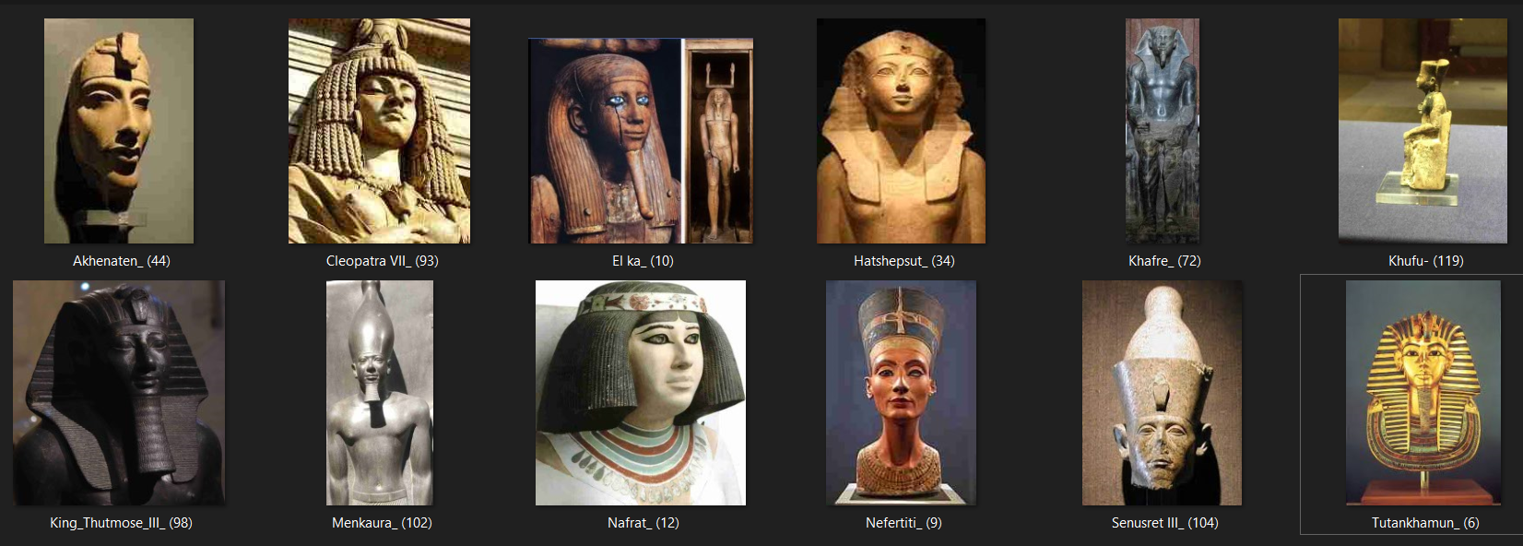
Dataset Cont.
Sample from new Dataset

Slide 26
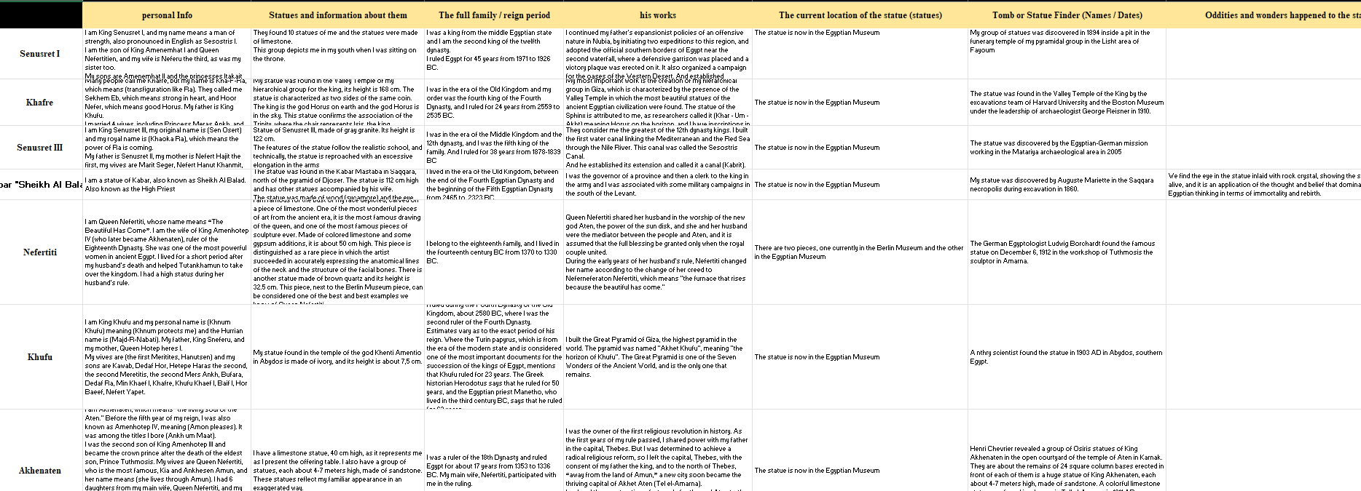
Dataset Cont.
Sample from Statues' information

Slide 27
05
Experiments & Results

Slide 28
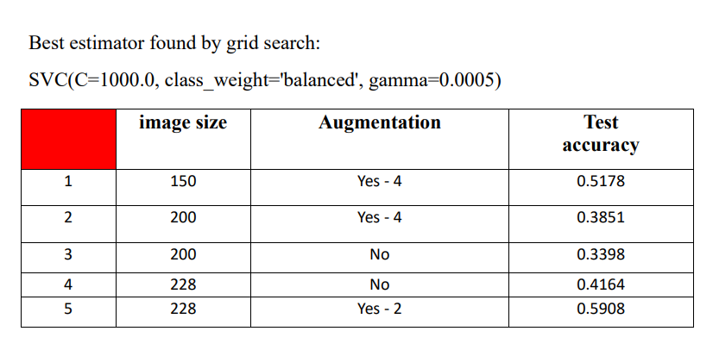
Experiments & Results cont.
Machine Learning Trails
SVM machine learning model

Slide 29
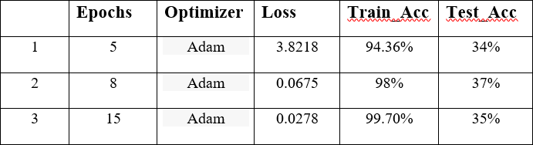
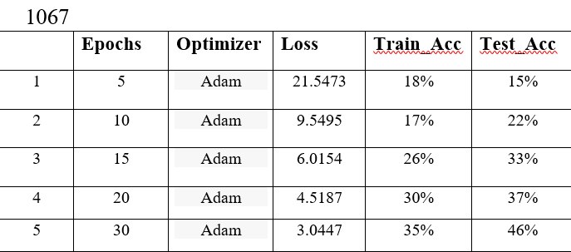
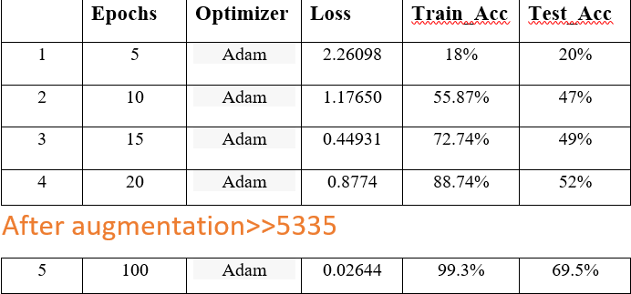
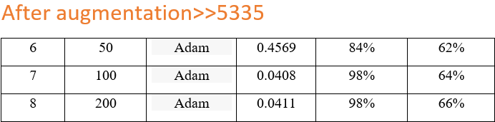
Experiments & Results cont.
Experiments & Results cont.
CNN Models Trails
LeNet-5
AlexNet: 3 conv layers & 1 fc layer
Custom:5 conv layers & 2 fc layers

Slide 30

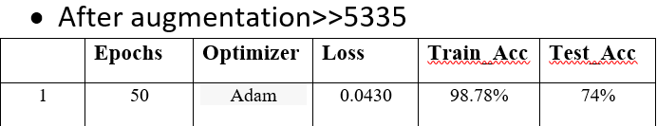
Experiments & Results cont.
Experiments & Results cont.
CNN Models Trails
VGG-19
VGG-16

Slide 31
Experiments & Results cont.
Experiments & Results cont.
Models Trails
Summary
Model | Augmentation | Accuracy
LeNet-5 | No | 37%
Custom | Yes | 69.5%
Custom | No | 52%
AlexNet | Yes | 66%
AlexNet | No | 46%
SVM | No | 41.64%
SVM | Yes | 59.08%
VGG-16 | Yes | 74%
VGG-19 | No | 92.76%
VGG-19 | Yes | 96.78%

Slide 32
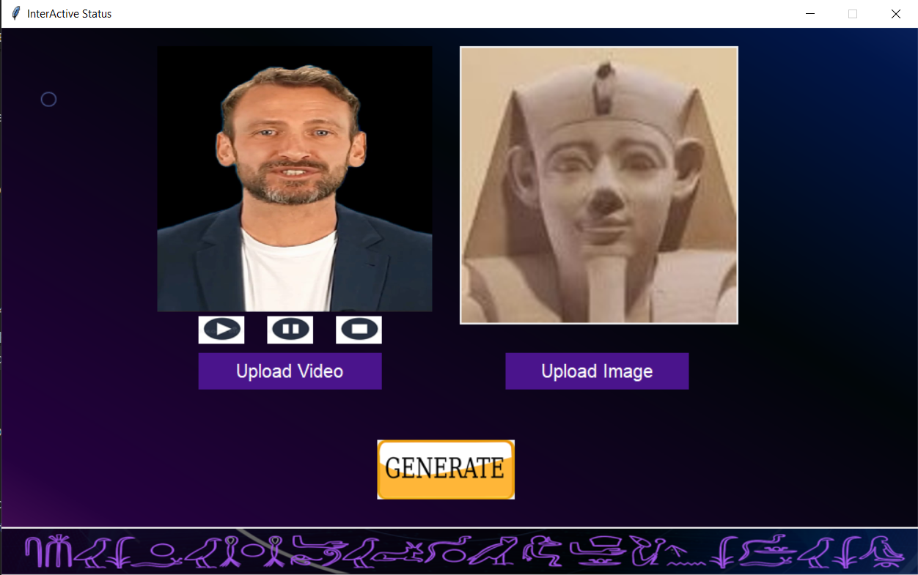
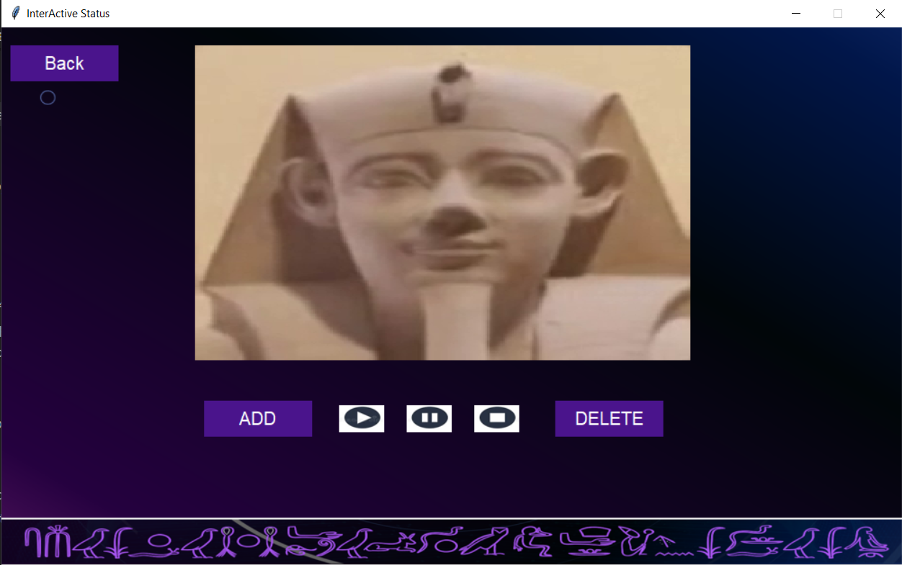
Experiments & Results cont.
First Order Motion Trails
Quality = 95%
Input
Output

Slide 33
06
Demo

Slide 34
Demo

Slide 35
07
Conclusion & Future Work

Slide 36

Conclusion
Our application depends on Deep fake videos for Egyptian statues to reduce the tourists‘ need for a tour guide and help them know a lot of information about them in an interactive & interesting way. It can recognize the statue's face and classify it by using CNN model.

Slide 37
Future Work
What is next…?
We are planning to:
Comprehensive Coverage of the Egyptian Civilization
Multi-Language Support
Expansion to Other Ancient Civilizations
Continuous Improvement of Deep Learning Models
Make our application as a product and market it.

Slide 38
08
Achievements

Slide 39
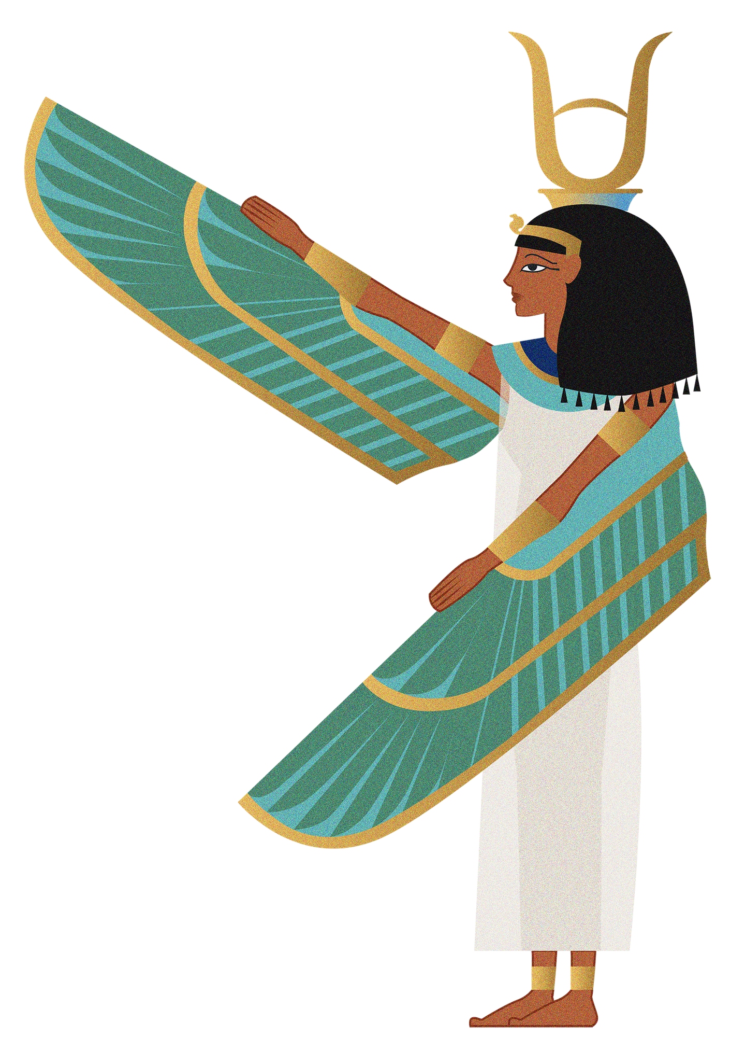
Achievements
First Place at FCIS innovates Competition

Slide 40
References
A. Online, "Ahram Online," 16 Mar 202. [Online]. Available: https://english.ahram.org.eg/News/491798.aspx. [Accessed 29 6 2023].
T. Shyamalee and D. Meedeniya, "CNN Based Fundus Images Classification For Glaucoma Identification," in 2022 2nd International Conference on Advanced Research in Computing (ICARC), Belihuloya, Sri Lanka, 23-24 February 2022.
S. Mittal, S. Srivastava and J. P. Jayanth, "A Survey of Deep Learning Techniques for Underwater Image Classification," IEEE, p. 15, 2022.
L. Gaur, S. Mallik and N. Z. Jhanjhi, Introduction to DeepFake Technologies, taylorfrancis, 2022.
A. S. Bahar Uddin Mahmud, "Deep Insights of Deepfake Technology : A Review," arxiv, p. 10, 2021.
T.-H. Nguyen, N. T. Nguyen and M. B.-V. Ngo, "A VGG-19 Model with Transfer Learning and Image Segmentation for Classification of Tomato Leaf Disease," mdpi, vol. 4, no. 4, 2022.
A. Gasparetto, M. Marcuzzo, A. Zangari and a. A. Albarelli, "A Survey on Text Classification Algorithms: From Text to Predictions," mdpi, vol. 13, no. 2, p. 82, 2022.
J. Romer, Egyptian Civilization, Penguin Books, 2013.
I. F. a. H. al-Laithi, History of Ancient Egypt: Egyptian Civilization from the Early Pharaonic to the Islamic Conquest, Cairo: American University in Cairo, 2012.

Slide 41
Thanks !
Any Questions?

